Slide 1
Biohackathon Updates
bh2018paris - Day 4 – November 15
Notes:
21 not presenting as 1 day Hack
28

Slide 2

01-OmicsPath
3 bullet points recap aims (current participants No 1 and duration 4 days)
Data import from reactome database and convert to omicsdi format
Pathway Analyzer
Similar Pathways
3 bullets to describe achievement
We got data from reactome pathways and CRUD operations performed in mongodb.
Pathways corresponding to molecules of datasets are retrieved.
Pathways converted to omicsdi format for each dataset.
2 bullet of what help you need from whom
Java, Scala, frontend , recommendation engine knowledge developers are most welcome.
next steps
implement similarity using pathways for datasets

Slide 3
02-CompactIdentifiers
3 bullet points recap aims (current participants No and duration )
Run your own Identifiers.org Metaresolver ✔︎
Access Identifiers.org new Cloud API via cloud-libapi ✔︎
Contribute to the development of IdentifiersJS library ?
3 bullets to describe achievement
Prototype Machine Learning based method improving our reliability scoring service accuracy by 30%
2 bullet of what help you need from whom
Any Machine Learning with NLP skills in the audience? (DeepLearning4J or TensorFlow)
Any Javascript Ninja?

Slide 4
03-BioTools-EDAM
recap aims
explore more sustainable / accessible way to manage tool information & curate bio.tools
verify the data formats supported by tools (in bio.tools) and formalise the relationships (in EDAM) between types of data and data formats
DRAFT-03 of the Bioschemas Tool profile, together with 24-ToolsMetadata and 11-Bioschemas
improving interoperability with the general schema.org
better alignment with schema (biotoolsSchema) and Tool Info Standard used by bio.tools, and with biii.eu
achievement
outlined a new architecture (based on GitHub) for curating tool information, that will make bio.tools content management easier, and enable other projects & individual developers to more easily contribute to & use the data
developed a utility to extract and compare all the existing associations between types of data and formats from bio.tools and EDAM (992 unique data<->format associations in bio.tools, 95 is_format_of relations in EDAM)
revision (ongoing) of Bioschemas Tool profile, together with 24-ToolsMetadata and 11-Bioschemas
next steps
discuss & plan the tool information architecture more
apply the data<->format associations to curate & enhance bio.tools and EDAM, repeat with operation & topic

Slide 5

04-BioJS
Goals
Add example visualisations back on registry website
Revive education/tutorial site
Work towards Galaxy integration/component interoperability
What we’ve done so far (2 full time, a few part-time contributors)
Started working BioJS quality checker module - has a simple check for docs already
Working on Galaxy integration prototype
Still working on reviving visualisations in the registry
What we need
More manpower/time

Slide 6
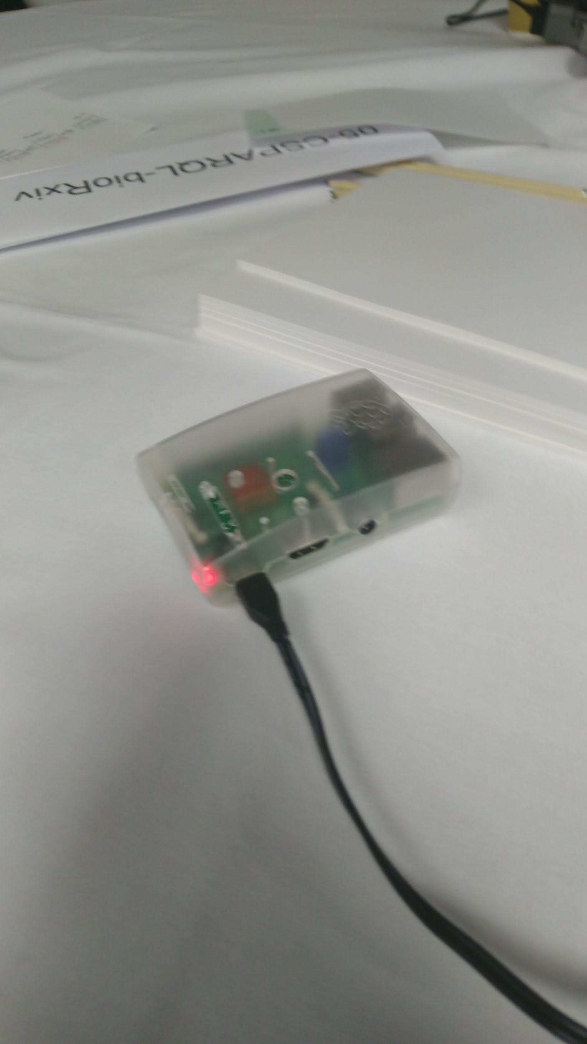
05-CSPARQL-bioRxiv
Project aims
Your survival toolkit in the modern avalanche of publications.
Process streaming data from twitter feed to provide real-time publication notifications to users with a sparql compatible web interface.
Extract semantic features (e.g. topics) and combine them with ontologies such as EDAM, Biotea.
Achievements :
Web interface is updated with advanced search for filtering multiple properties.
Twitter streaming processing is completely integrated to rest of pipeline.
Initial results from statistical topic modelling. Need more processing and/or better representation of data to improve results.
Biorxiv html parser is implemented.
What help you need from whom
Ideas on improving topic modelling are always welcomed!
Notes:
<3

Slide 7
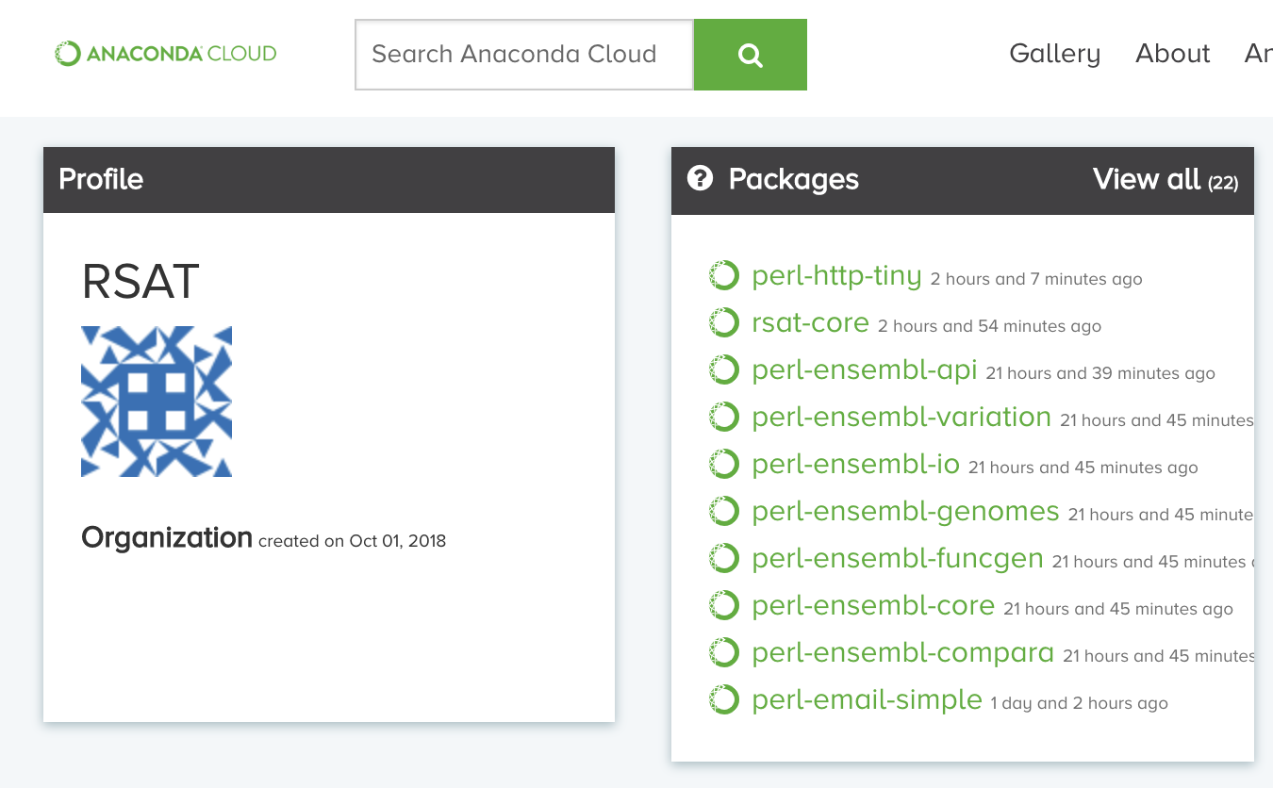

06-Bioconda-RSAT
Initial goals
conda install -c bioconda rsat-core
conda install -c bioconda rsat-data
conda install -c bioconda rsat-web
Current status:
conda install -c bioconda -c conda-forge -c rsat rsat-core
New dependencies packaged
vmatch + mkvtree:
Authorisation by Stefan Kurtz to redistribute via conda
Ensembl API (Perl modules)
First version of packages implemented here by Aurélien Naldi
Contact taken with Andy Wales @ Ensembl about perspectives to distribute Ensembl as conda package
Enthusiastic response from Ensembl, conda packaging projet will be pursued by them
Next steps
Rationalize access to the numerous Perl and python scripts (as sub-commands of a generic rsat command)
Add functional tests in the conda metadata and run install tests on different OSs
Transfer packages from the temporary conda rsat channel to bioconda
Clean package: suppress obsolete scripts and dependencies
Ansible recipes to deploy web server

Slide 8
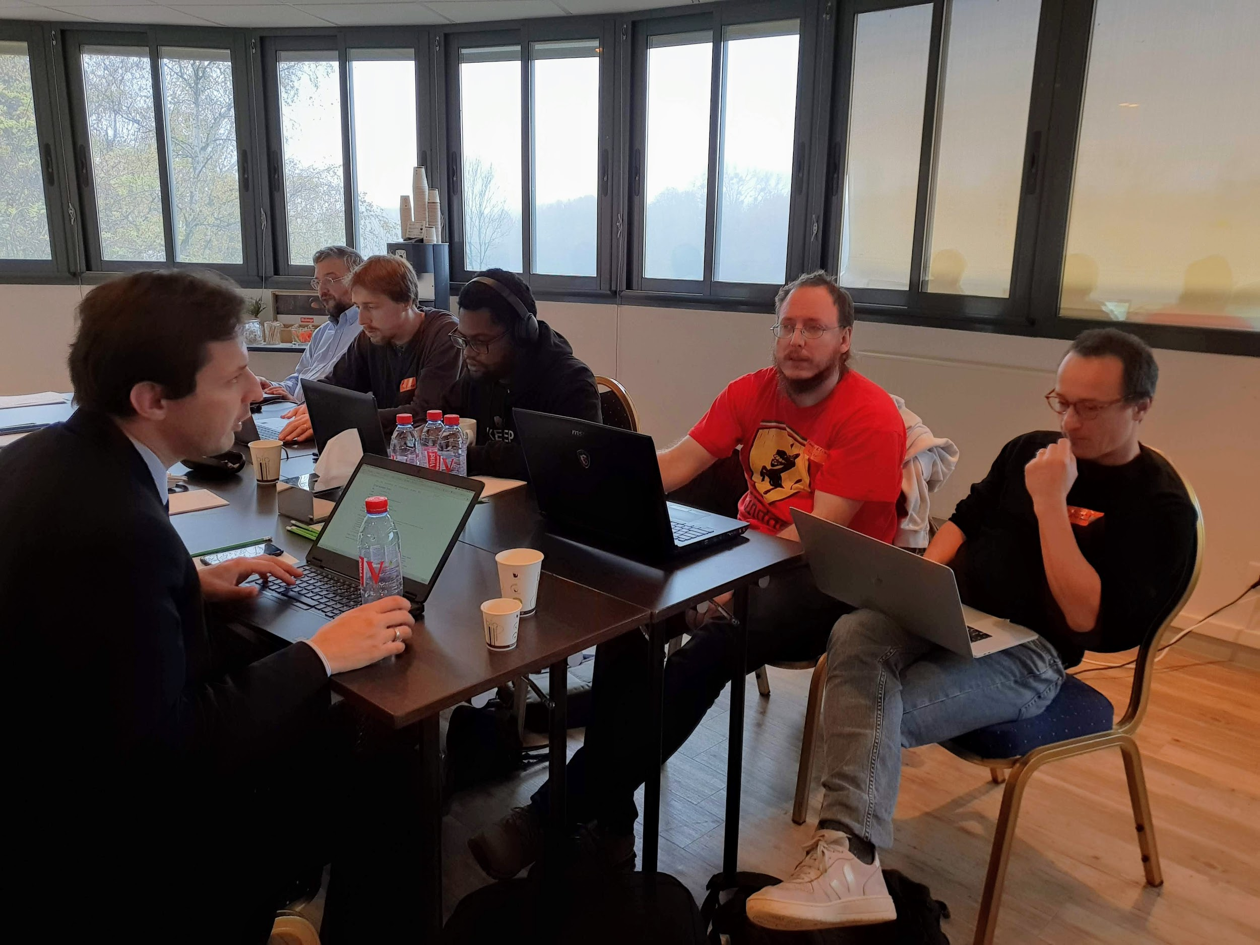
07-Pharmacogenomic LOD (PGxLOD)
Aims (recap)
1/ Improve PGxLOD (4 persons)
2/ Explore PGxLOD for ADR explanations (4 persons)
3/ Develop an observational PGxLOD (2 persons)
Achievement
1/ Linguistic reconciliation ontology and system for normalization of complex phenotypes, such as drug response phenotypes
2/ Defined 3 sets of ADRs (including positive/negative examples) for the building a training set
3/ Ongoing linking between the PGxObservational schema and RDF FHIR (HL7 extended)
Help / Advice needed
Graph mining

Slide 9
08-DataClearinghouse Validation and Curation...
3 bullet points recap aims
Being able to reuse curated resources like MarRef database to curate BioSamples
Export Breeding API data to ISA tab and validate the results against MIAPPE
2 bullets to describe achievement
Created a proof of concept for a MarRef API with Spring and Scala
Export JSON and JSON-LD from MarRef
Refactored all the code to be production ready to convert messages from BrAPI endpoint to generate a valid and possibly MIAPPE compliant ISAtab file
creation of an ISA configuration for MIAPPE v1.1
1 bullet point of what help you need from whom

Slide 10
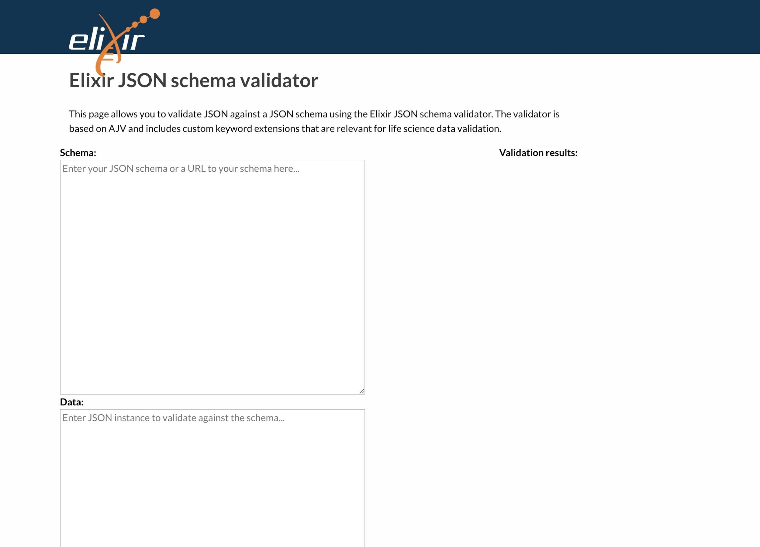
09-OntologyValidation
Task
Build a repository of AJV (https://ajv.js.org) JSON schema plugins for keyword extensions
Implement ontology term validation extensions
Progress
Validation service with API and UI
Dockerised and deployed to dockerhub
Next steps
Integration with data clearinghouse validation
More docs!
docker pull ebispot/elixir-jsonschema-validator

Slide 11

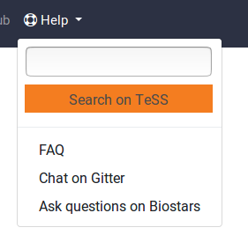
10-Galaxy Training Material
3 bullet points recap aims (3 participants, more online, everybody welcome)
New content creation and improvement of existing materials and framework
Instructor Handbook
Internationalization/localisation of materials
3 bullets to describe achievement
Search on TeSS menu embedded on website
Discussed combining forces with carpentries for shared workshops
14 new pull requests opened (15 merged)
2 bullet of what help you need from whom
Evaluate automatic translations; add to our list of words that should not be translated
Native speakers to simplify and improve the English text
Share your training philosophy (on this github issue)

Slide 12

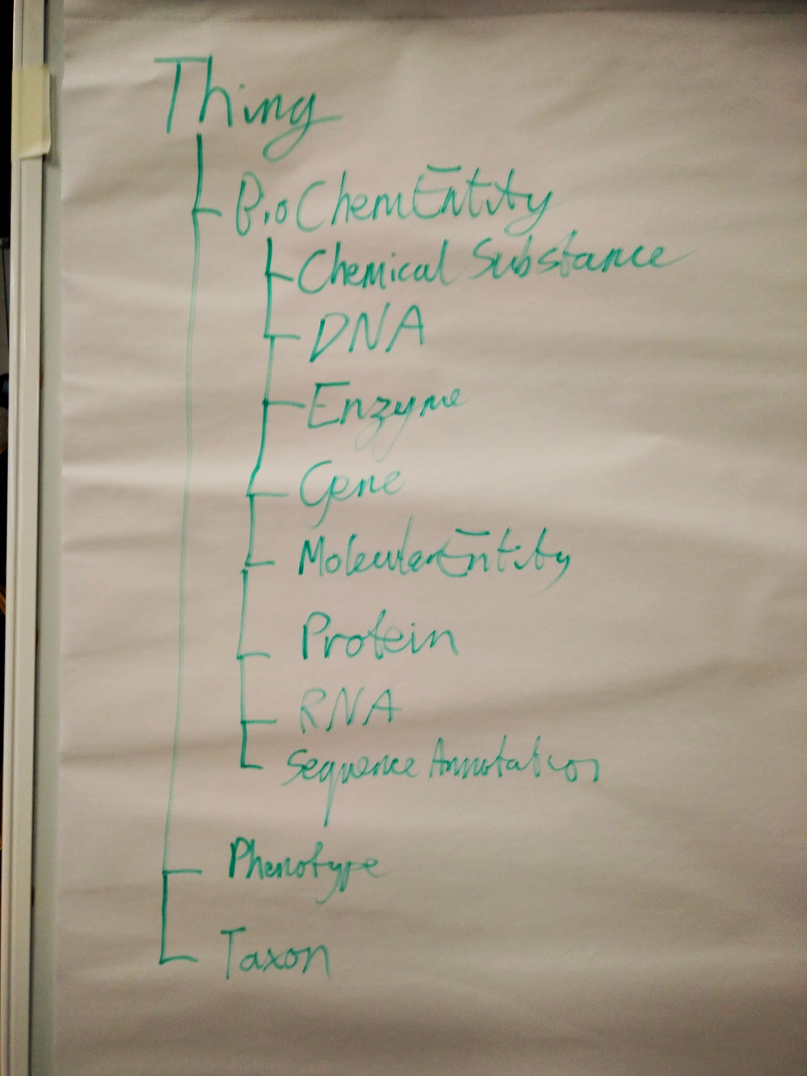
11-Bioschemas
Recap of aims (three tables, 30+ people)
Marked up resources
Create/Refine profiles: Gene, Protein, Studies, DNA, Molecular Entity, Chemical Substance, ...
Develop support tools
Achievements
Multiple resources marked up
Using Dataset, DataCatalog, Gene, MolecularEntity, ...
Some live deployments! Many beta deploys.
Refined type hierarchy and properties:
Search focus – not ontology modelling!!!
Many new profiles: Phenotypes, Studies, Tools, ...
Next steps
Generate examples of new types/properties
Create types/profiles for the refined hierarchy

Slide 13

13-SPARQL-RareDiseases
3 bullet points recap aims (4 days, 5 participants so far )
Provide catalogue of relevant resource in the Rare Diseases field, available through SPARQL
Setup queries catalog
Federated queries accross sources
3 bullets to describe achievement
add sparql description : good to know the technical details (which version of endpoint etc.)
run queries around Orphanet Rare Disease ontology and Chembl
setup queries using wikidata
having a logo for our catalog
next steps
Shex (still need) and / or sources schema (start with disgenet and Ordo)
add ranking system (https://yummydata.org/endpoints)

Slide 14
14-Orphanet-PhenoScrapper
Project aims (4 days / David Salgado - Toyofumi Fujiwara - David Lagorce)
Speed-up the process of Orphanet disease-HPO annotation and improve curation process
Achievement
Close to achieve development of “PhenoMarker”.
Succeed:
to grab text informations from with publications PMID/PMC.
to embed in the pipeline PubCaseFinder webserver in order to scrap HPO annotations https://pubcasefinder.dbcls.jp/
to graphically highlight HPO terms in the text (from a defined level of the HPO classification)
in progress
compare with HPO terms already used to annotate a disorder.
adding interactivity between HPO terms and document.
searching a way to counting/scoring each terms for one document

Slide 15
15-GA4GH-WES
Aims
Pluggable workflow engines (1)
Task distribution (1.5)
Authorization & authentication (2)
Production-grade deployment (4.5)
Achievements
Implementing “proxy” TES endpoints
Working on the simple UI client for WES/TES authentication. WES/TES auth flow in place.
Deployed WES in OpenShift.

Slide 16
16-Alternative episodes for the 4 Open Source Software (4OSS)
recap aims (current participants No and duration )
Fotis, Mateusz, Paula, Victoria, Denise
no more GitLab (it’s not possible to connect with release on Zenodo)
adding content as the optional part of the “make your software open” episode
achievement
Making your software reusable with Docker - now merged into the 4OSS lesson
Sharing and collaborating with Notebooks - draft version, under review (thanks to Loic for giving us some great ideas and tips!)
Added lesson provenance in the README (i.e. people who use the 4OSS material should add a new entry in the provided table as a PR)
2 bullet of what help you need from whom
the more the merrier / review of the material would be useful
Do you use notebooks for research? how? why?

Slide 17
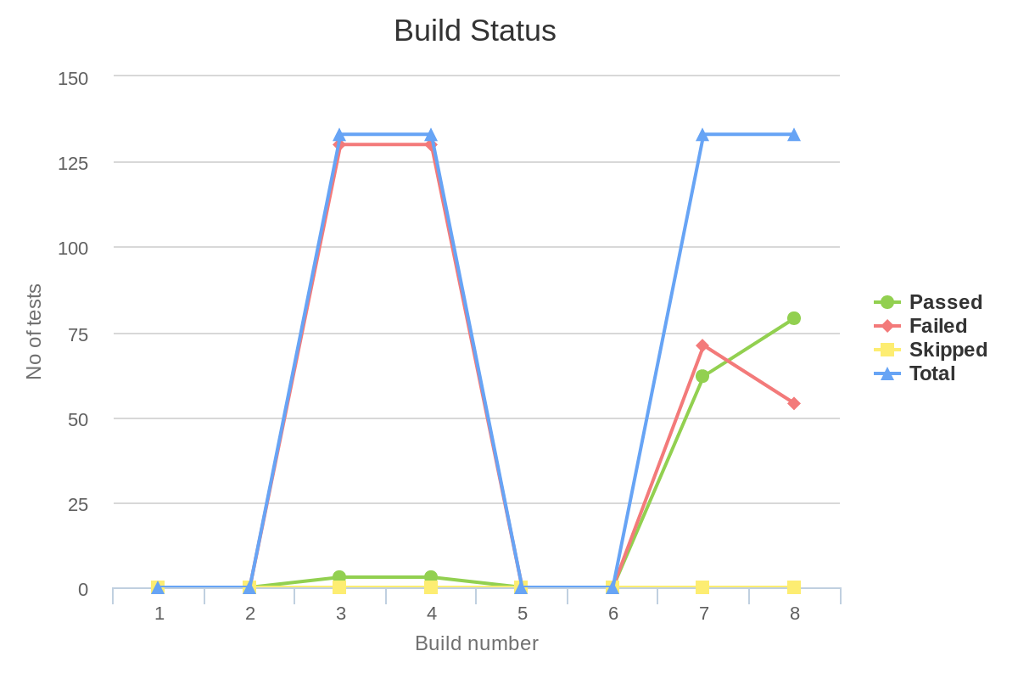

17-CWL-Galaxy
Participants: Michael R. Crusoe, Manabu Ishii, Stian Soiland-Reyes, John Chilton, Nicola Soranzo, Arnaud Meng, Hervé Ménager, Pau Ruiz Safont, Pjotr Prins, François Moreews, Jérôme Raciazek
Achievements:
Development:
Galaxy-CWL: 79 tests now pass at ci.commonwl.org (not just in John Chilton’s hands)
The Galaxy-CWL fork UI can now run CWL workflows with simple* inputs
CWL-born PR to galaxyproject/galaxy (Nicola)
Minor corrections to the CWL Metagenomics workflows
CWLProv code in the CWL reference runner was refactored to be more usable by Toil and others: https://github.com/common-workflow-language/cwltool/pull/975
Discussed a strategy for preservation of Docker container images; also serving them from IPFS
Revised the CWLProv paper

Slide 18
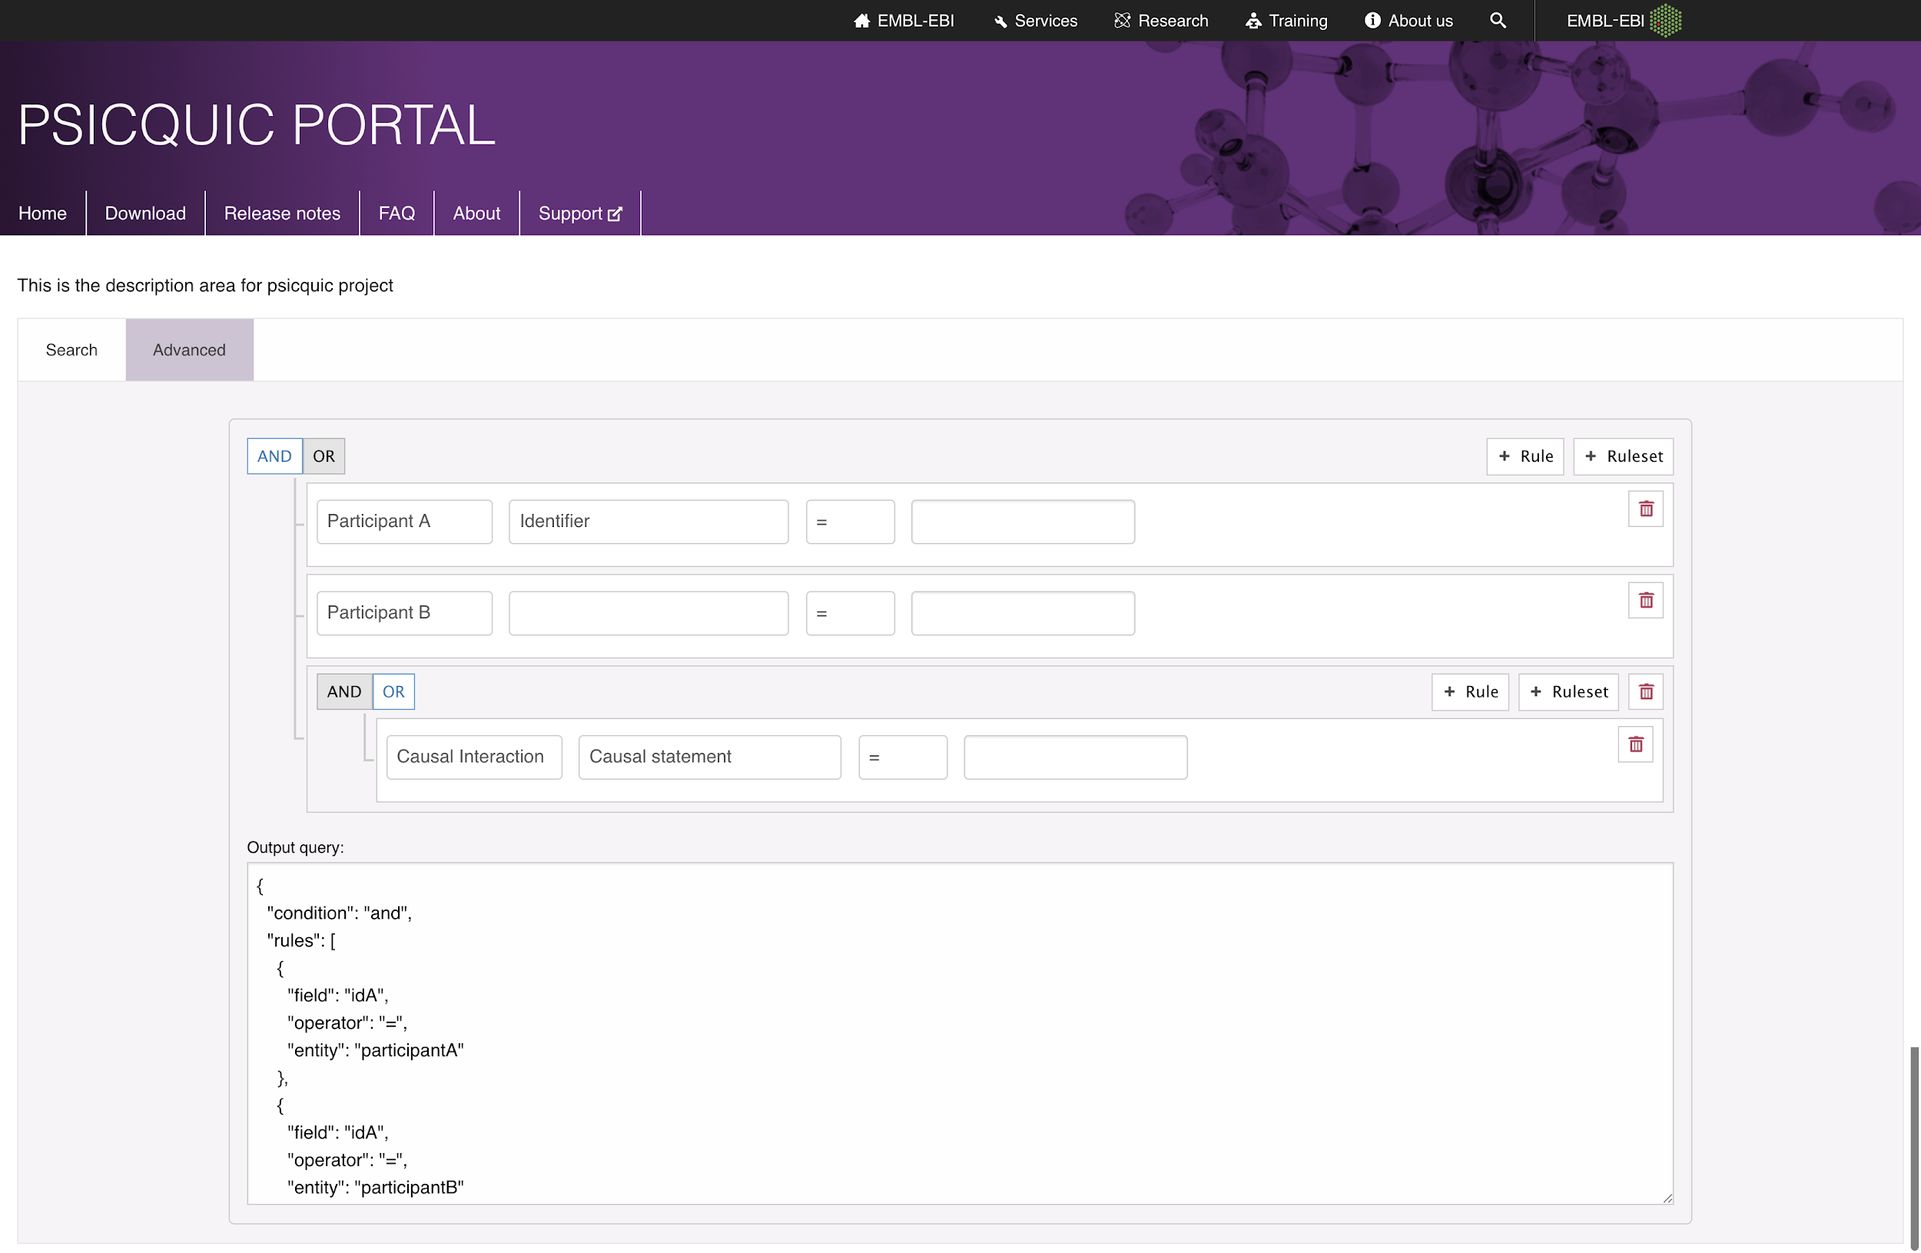
18-PSICQUIC_2.0
4 bullet points recap aims (Noemi del Toro, John Zobolas, Elisabet Barrera )
myPsicquic
PSICQUIC Cluster
PSICQUIC Extensions
PSICQUIC View
3 bullets to describe achievement
Writing and reading miTab 2.8. Testing in progress
Writing queries with jquery builder and integration
of the component
1 bullet of what help you need from whom
?

Slide 19
19-MetagenomicsMetadata
3 bullets points recap aims (just me)
Create a universal model to infer amplified 16S regions in amplicon data using HMM
Integrated script into production pipeline / create CWL tool
Expand to 18S data
3 bullets to describe achievement
16S + 18S models work
Integrated into pipeline
CWL tool description is underway
Integrated into our API

Slide 20
20-Shiny-RStudio-Galaxy
HIDDEN Slide: Our hack was only for 2 days.

Slide 21



21-FAIR-TrainingMaterials
Aims and achievements
Discussion: What is a training material, what does FAIR mean for training materials
“training material” definition
Comprehensive list of metadata for training materials
Assessed some training with FAIRNESS matrix
[Working on] Bioschemas specification creation for Course and CourseInstance
what do you need .
People interested in helping us complete the new Bioschemas Training specifications

Slide 22
22-FAIRDOM-SEEK-ResearchAssets
3 bullet points recap aims (current participants No and duration )
Exchanging assets between SEEKs
Galaxy integration
Incorporating Bioschemas
3 bullets to describe achievement
Solved Galaxy authentication issue, short term and longer term. Thanks for help from Bjorn & Frederik!
Have a clearer idea of how to implement bioschema, and started putting together a solution that will allow rapidly adding markup.
Post hackathon steps
Tidying up and adding test cases
Continue describing bioschema markup for all appropriate types & properties.

Slide 23
23-RDF-ModelsAndTools
3 bullet points recap aims (current participants No and duration)
7 participants
Developing applications using available RDF datasets and SemWeb tools
International collaborations with the other topics, aim to continue in the NBDC/DBCLS BioHackathon in Matsue on December
3 bullets to describe achievement
Created a docker image of the web API for SPARQL Builder.
Updated SPARQL libraries as building blocks for developing applications
Set up an inference engine on the basis of SPIN rules using Virtuoso 8
2 bullet of what help you need from whom
Feedback using these tools
Suggestion on applications combining these tools

Slide 24
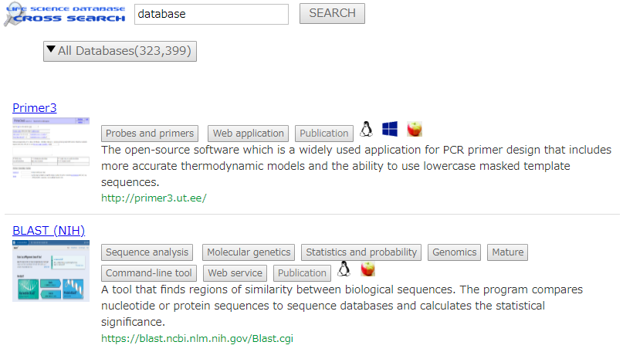
24-ToolsMetadata
Project aims (4 participants )
To markup pages of biological databases and tools
To make rich snippets of biological databases and tools in search results
Achievement
Discussed about good schema data on search result with 03-BioTools-EDAM.
Mockup of search result =====>
We need your comments.
Tomorrow, we will construct the markup form for optimizing biological research information retrieval.
Elements:
inspired from bio.tools
datasets
from bio.tools API
keywords:
bioschema.org
thumbnail images:
we will capture everyday.

Slide 25
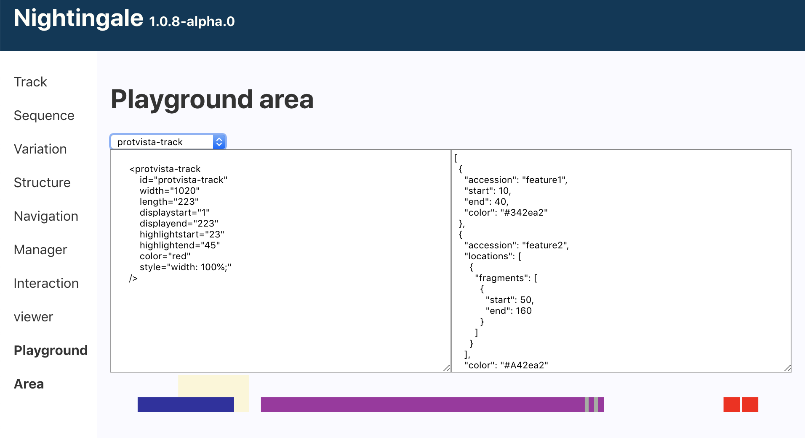
25-ProtVista-Bioschemas
3 bullet points recap aims (current participants No and duration )
👍🏽To define a way to represent protein domains with bioschemas
👎🏽To take this info from a website, and represented with Nightingale
3 bullets to describe achievement
🥳 Interactive demo area for Nightingale
🤝Agreements with BioSchemas people about sequence location.
🤓Playing with React Hooks and Suspense
2 bullet of what help you need from whom
Any other protein services interested in providing this sort of info

Slide 26
26-Blockchain-TrackingBioSamples
3 bullet points recap aims (current participants No and duration )
3 participants, 4 days.
Use blockchain technology to support provenance and sample supply chain management.
BioSamples as surrogate for other biomedical samples
3 bullets to describe achievement
Code the transaction logic in JS to apply different curation layers in an existing sample.
Document a curation example.
2 bullet of what help you need from whom
Validate curation transaction with BioSample team

Slide 27
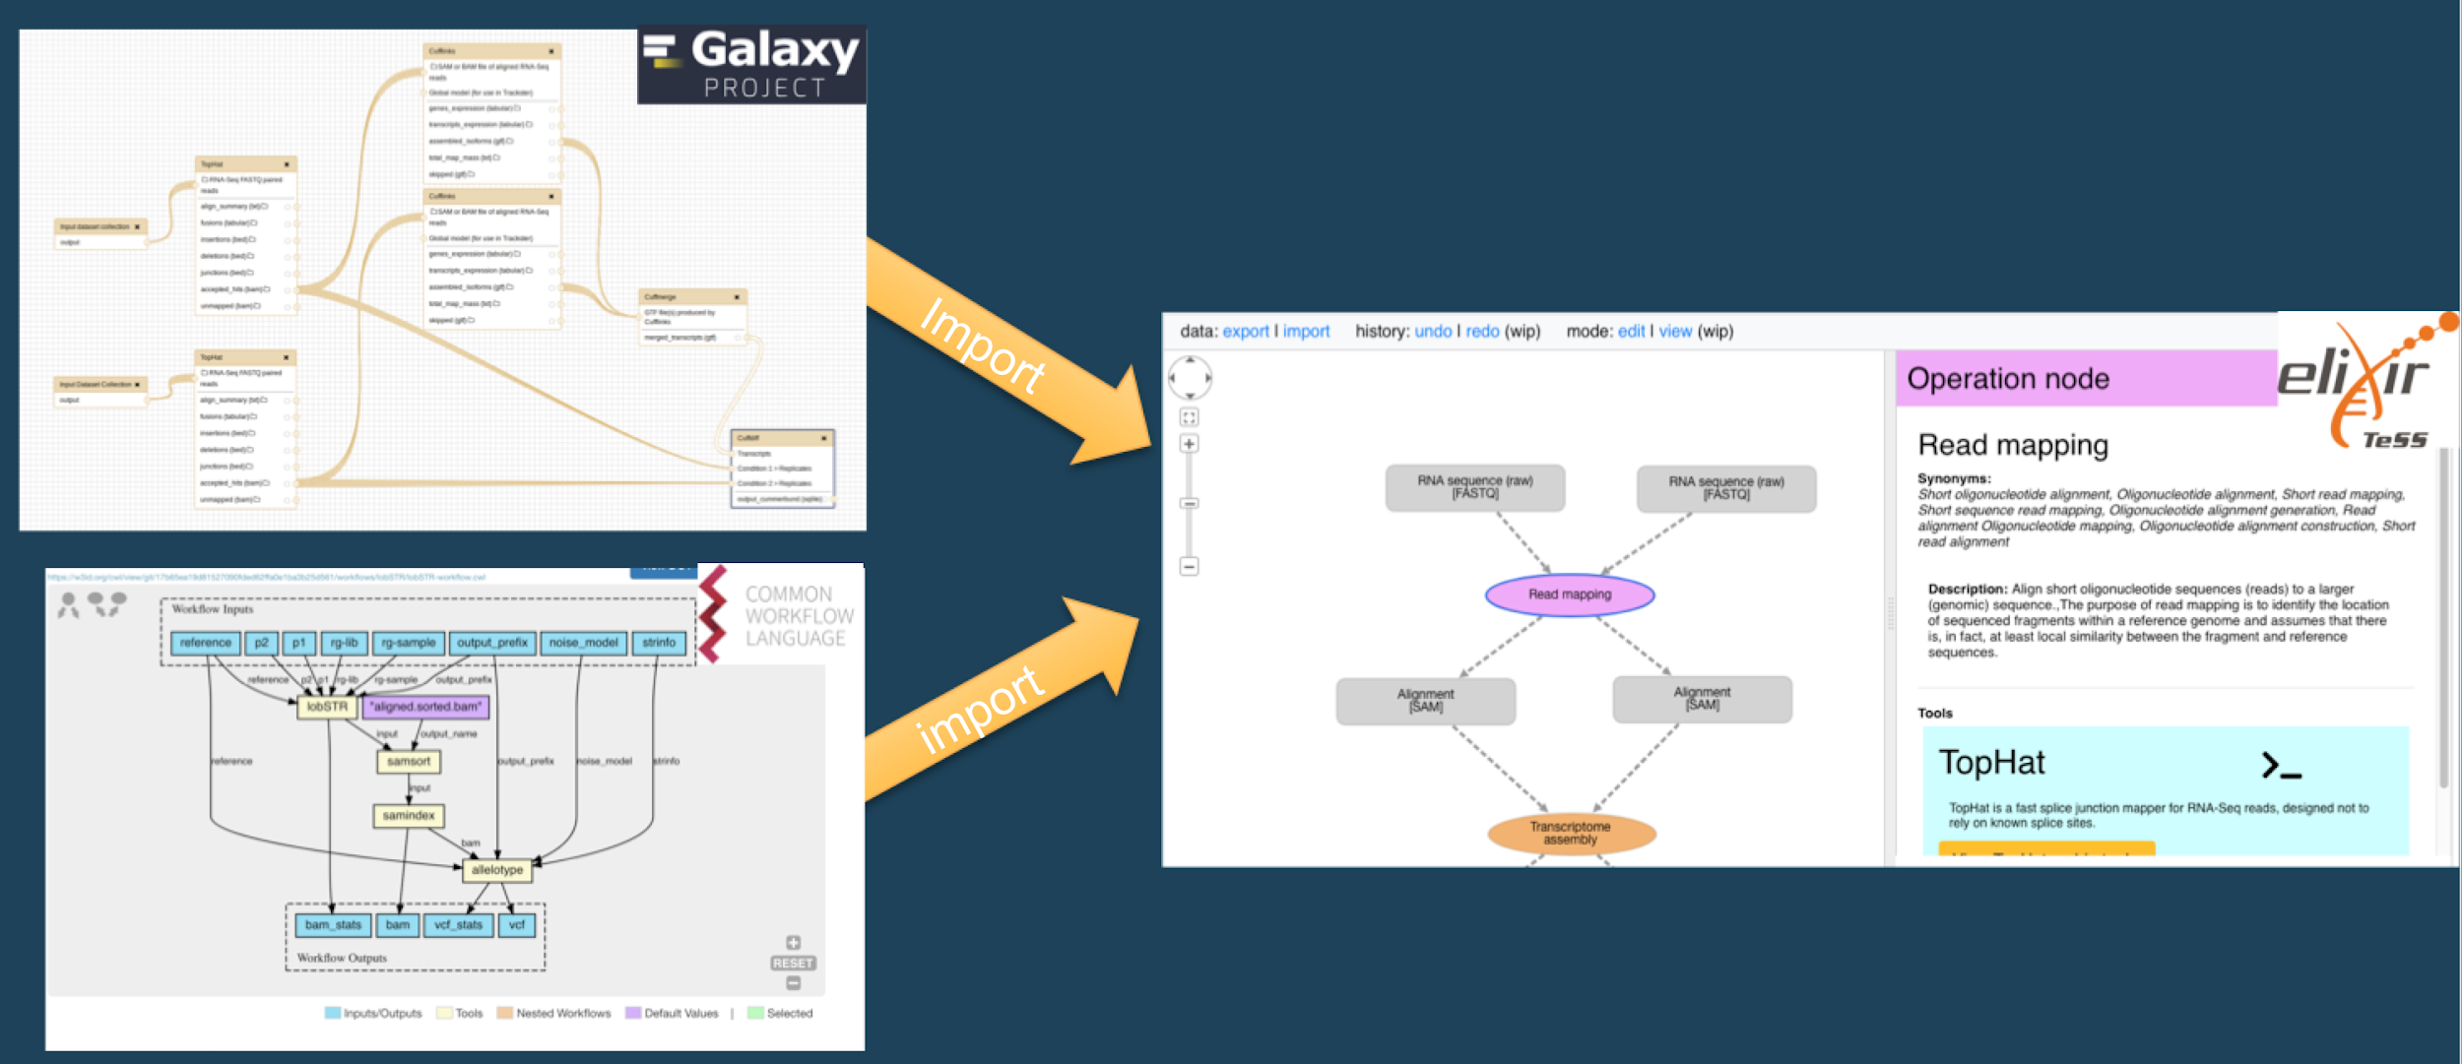
27-TeSS-ConceptMaps
Import Workflows into Concept Maps to make linked, interactive Training Resources!
Concept Maps teach people what the core concepts of typical data analysis pipelines are
They are annotated with EDAM Operations/Data/Formats and offer helpful links to bio.tools and FAIRSharing
The task is to create skeleton Concept Maps by importing Workflows
Progress
✓ Command-line tool to make the tool more usable
✓Now supports CWL AND Galaxy Workflows!
✓ Discussed (Ivans) EDAM Select component from Concept Maps
Plan to include in biojs
Ideas to improve usability
Integrate with bio.tools
? Still working on making content. Working with content from Veit and Berenice
Help Needed
Workflow/Training experts

Slide 28


28-Biotea-Bioschemas-Publications (not started yet) XXXXX
→
Aims
Map Biotea model for metadata and references to Bioschemas profiles
Journal, PublicationIssue, PublicationVolume, ScholarlyArticle
3 bullets to describe achievement
What is still missing?

Slide 29
29-ProteinTargets-KnowledgeNetworks
Main aims (current participants 2, duration 4 days )
Create linked/integrated data defining drug, protein target, pathway and phenotype relationships
Providing a better understanding of these data by enabling the interrogation of data via
SQL: all sort of queries
Graph: motif discovery, subgraphs, graph algorithms (connected components, Label propagation, shortest path, etc)
Improve drug pathway effect prediction tools
Day 2 achievements
Consumed data resources using Zeppelin/Spark (DrugBank main resource to do)
Experimental GraphFrame created (but not complete)
Would anyone like to help with
Consuming data using Zeppelin/Spark
Merging data for graph dataframe.

